Slide 1
R Bootcamp
August 23-24, 2021

Slide 2
Roadmap
Big picture
R interface
R basics (vectors, factors, dates, matrices, lists, data frames, functions)
Data Import
Data Wrangling
Visualization
Analysis

Slide 3
Q & A
How many of you have used R in the past?

Slide 4
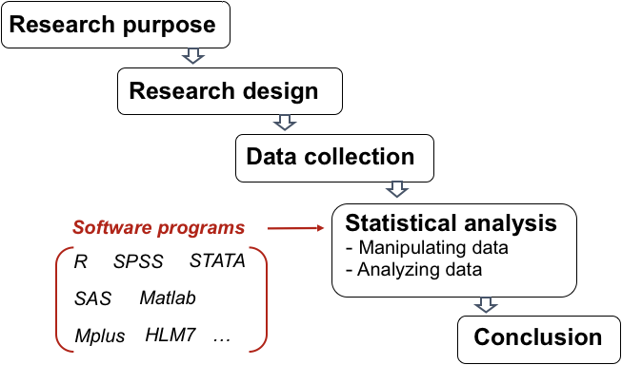
Big picture
MFRE’s comparative advantage is in causal inference and economic interpretation of results
Programming is a cross-cutting tool that helps us to analyze, model, visualize, and communicate data.

Slide 5
Typical analytic workflow
Install and load necessary packages
Import data
Clean/Transform data
Explore data
Resolve structural issues
Model
Analyze and interpret
Communicate the results
https://craig.rbind.io/post/2019-05-17-asgr-basic-workflow/

Slide 6
Why R?
Free and open-source
Popularity in economics, other disciplines, and also industry
Great for reproducibility
R Markdown
Flexibility
GIS, machine learning, databases, version control, website and apps, presentations, etc.

Slide 7
Resources for learning R
Link to various R resources compiled by Nick Huntington-Klein
R for Stata Users by Mattieu Gomez
Work through different case studies
UBC STAT545 material
Hadley Wickham’s R for Data Science

Slide 8
Getting help
Google!
Stack Overflow
Rstudio Community
Twitter #rstats
?plot

Slide 9
When you want to ask me or any MFRE professor or staff any programming issue…
Use your UBC email. Use a meaningful email subject.
Greet. Politely.
Launching straight into the message is bad, but “Hi!” is poor form and “Hey Prof!” is an unmitigated disaster. “Dear” and “Hi” are fine, so long as you follow both by a name or title: “Hi Professor” or “Hi Dr. ___” or “Hi ____”.
Check your spelling, grammar, and punctuation – reputation effects
https://chrisblattman.com/2010/11/08/students-how-to-email-to-your-professor-employer-and-professional-peers/

Slide 10
When you want to ask me or any MFRE professor or staff any programming issue…
Describe your problem. Explain how you encountered the problem and the different solutions you have tried.
Help us reproduce the problem.
Include your data (or a sample of the data) and the code you used
Include a screenshot of the errors you get

Slide 11
Some differences with Stata
Multiple objects can exist in the same workspace
Packages
Availability
Need to load packages at the start of every new R session.

Slide 12


R and RStudio
R is a programming language and a free statistical software environment
RStudio is an integrated development environment (IDE) for R programming.
When I say R, I mean we will code using R in RStudio.
Always remember: R is the programming language. RStudio is the IDE.

Slide 13
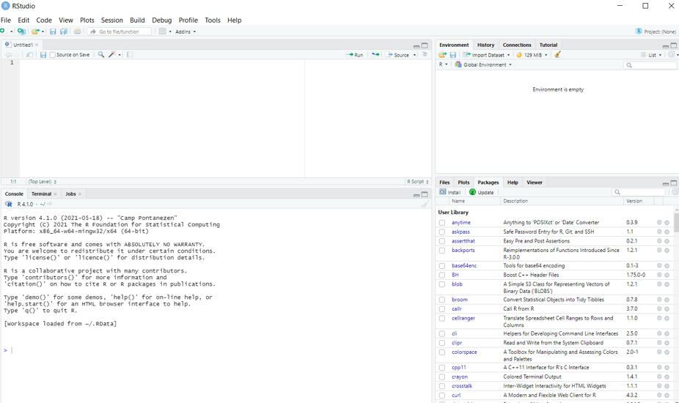
RStudio Interface
Notes:
When you open Rstudio for the first time, you will see the following interface
The upper left is the source editor. This is like Stata’s do file. This is where you write your code, which we call “script.” Basically it’s just a textfile but saved with a .R extension. You will likely spend most of your time writing in Rstudio on the source editor. Your code will not be evaluated until you click “run” or ctrl/cmd+enter. You should do most of your coding here, so you can save it and get back to it later.
The lower left window is the R Console. It’s the brain or the heart of R. If you were to run your codes in R instead of Rstudio, you would only see this window. If you type a code here, it will execute it immediately. For example, you can type 1+1 into the console, and R will give you an output of 2.
The upper right is the workspace browser and history. You can see the objects in your workspace as well as the commands you have executed.
The lower right contains the files/plots/packages/help/viewer and also access R help.

Slide 14
RStudio Interface
You can also change some settings (Tools > Global Options)
Theme (Appearance)
Parentheses (Code > Display tab > check rainbow parentheses)
Code wrapping (Code > Editing tab > check Soft-wrap R source files)

Slide 15
Managing the workflow
It’s good practice to keep related data, scripts, output, papers, etc. in a single folder called a working directory.
setwd(“path/that/only/works/on/my/own/laptop”)
To have a better workflow in RStudio, we will use the built-in R Project function.
Why?
Read more here: https://www.tidyverse.org/blog/2017/12/workflow-vs-script/

Slide 16
Creating a new project
Under File -> New Project -> New Directory -> New Project
Enter a name for this folder (“r-bootcamp”) and choose a convenient location.
This folder will be your working directory for the rest of the bootcamp.
getwd()
Click on Create Project -> New R script -> save it as dayone.R

Slide 17
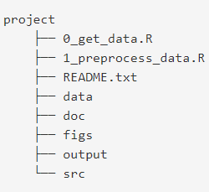
Organizing your directory
Use meaningful names as file names
cleaning_data.R vs script1.R
https://kdestasio.github.io/post/r_best_practices/

Slide 18
Interacting with R
Two ways to code
Console
Script files (source editor)
To execute/run our code from the source editor
ctrl + enter in Windows
cmd + return in Mac
Note: .R scripts is analogous to .do file in Stata
Notes:
The basis of programming is that we write instructions for the computer to follow. And we tell the computer to follow those instructions. We write or code instructions in R because it is a common language that both you and the computer understand. We call the instructions commands, and we tell the computer to follow the instructions by executing/running those commands.
Because we want our code and workflow to be reproducible, it is better to type the commands in the script editor and save the script for later on. This way there is a complete record of what we did.

Slide 19
Interacting with R
If you see the “>” prompt, that means R is ready to accept new commands
If you see the + prompt, that means R is waiting for you to enter more text, i.e. your code is still incomplete
Missing a parenthesis or quotation
To cancel this incomplete command, press Esc on your keyboard while inside the console window

Slide 20
Packages
“A package bundles together code, data, documentation, and tests, and is easy to share with others”
If you are struggling to accomplish a certain task, it is very possible that someone has already solved your problem and created a package for it.
As of June 2019, there are 14,000 packages on the Comprehensive R Archive Network (CRAN)
Is this a good thing? A not so good thing?
https://r-pkgs.org/intro.html

Slide 21
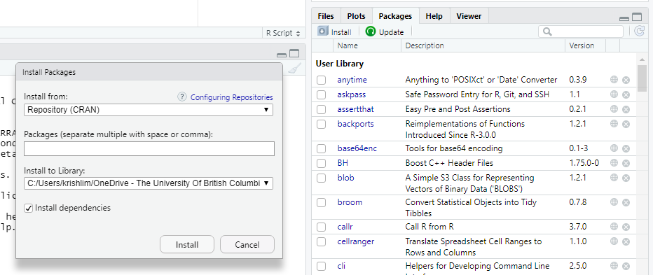
Packages
You install packages with the command install.packages(“package_name”)
Don’t forget the quotation marks!

Slide 22
Packages
To install multiple packages at once, you can use the code
install.packages(c(‘package1’, ‘package2’,…))
Try it now!
Install the packages tidyverse and readxl

Slide 23
Packages
We always have to load libraries every time to start a new R session – key difference with Stata
A few ways to load a library
Click the checkbox beside the package you want in the package tab
Type in library(package_name) in the console
Quotation marks are now optional.
You may also see some people use require(package_name)

Slide 24
A more efficient way
Google it – “How to load a bunch of libraries in R”
We can use the p_load() function in the pacman package to check if a certain package is already installed, and if not, install and then load it.
The p_load() function can be used to load multiple packages at the same time
install.packages(“pacman”)
pacman::p_load(tidyverse, readxl, googlesheets4, readstata13,here, magrittr, cansim, stats, broom, modelsummary, flextable)
https://statsandr.com/blog/an-efficient-way-to-install-and-load-r-packages/
Notes:
Package::function() makes it easy to identify which package that particular function lives in. Can be useful when there are multiple functions of the same name

Slide 25
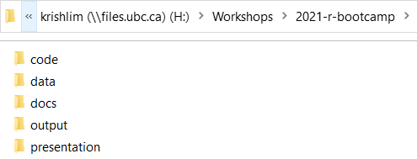
The {here} package
The here() package determines the top-level of your current project.
In my case, it is the H:/Workshops/2021-r-bootcamp
Use the here() function to build the path to read or write a file relative to the top-level directory
file = “H:/Workshops/2021-r-bootcamp/data/emissions.csv”
file = here(“data”, “emissions.csv”)
https://github.com/jennybc/here_here

Slide 26
Q&A
What are some of the packages you have used in the past and for what purpose?
Notes:
End of first hour

Slide 27
R Basics
Create, name, and assign values to objects
Use comments to inform script
Inspect, manipulate, and subset vectors, lists, and data frames
Call functions and use arguments to change default options
Deal with missing values in objects
Write your own function
Import your own function

Slide 28
Interacting with R
You can get output from R by typing math expressions in the console
1+2
2+4*1^3
100 %/% 60 # How many whole hours in 100 min
100 %% 60 # How many minutes are left over?

Slide 29
Interacting with R
You can get output from R by typing logic statements in the console
1 > 2 & 1 > 0.5 # The “&” stands for “and”
1 > 2 | 1 > 0.5 # The “|” stands for “or”
3 + 4 == 4 + 3 # The “==“ stands for “equal to”
3 + 4 != 4 + 3 #The “!” is negation

Slide 30
Creating objects in R
To do useful and interesting things, we assign values to objects
To create an object, the syntax we use is
object_name <- value
x <- 3
<- is the assignment operator

Slide 31
Creating objects in R
It is common practice to use <- for assignments, instead of =
You can name your objects anything you want, but they cannot start with a number and cannot use R reserved words (i.e. if, else, for)
R is also case sensitive (age is different from Age)
snake_case
PascalCase
camelCase
https://colinfay.me/r-assignment/

Slide 32
Creating objects in R
When we assign values to an object, R does not automatically print the object.
x <- 3 # does not print anything
(x <- 3) # prints the value of x
x #prints the value of x
2 * x #x is now stored in the memory; we can use it

Slide 33
Creating objects in R
We can also overwrite the value of an existing object
x <- 10 # we can also change the value of an object
x * 3

Slide 34
Commenting your code
It is very important to comment on your code
In R, we use the # character
Anything after # up to the end of the line will be treated as a comment, and R will not evaluate it as code
To comment/uncomment a chunk of code, highlight the lines then press ctrl + shift + c on your keyboard

Slide 35
Data object types
There are different types of objects in R, but common ones are
numeric_var <- 1
character_var <- “one”
factor_var <- factor(1, labels = ‘one’)
logical_var <- TRUE
as.character(numeric_var)
You can use class, typeof, str commands to understand and inspect these objects

Slide 36
Vectors
A vector is composed of a series of values, which be either numbers or characters.
All elements inside the vector are of the same type
We assign a series of values to a vector using the c() function
Types of vectors
character, numeric, integer, logical

Slide 37
Vectors
countries <- c(“Canada”, “Kenya”, “United States”)
countries
quotes around the text are important to indicate the data type character. If not, R will think it’s an object, and since these objects don’t exist in R, you will get an error
emissions <- c(53700, 14300,5250000)
emissions

Slide 38
Vectors
We can add values to existing vectors
countries <- c(countries, “China”)

Slide 39
Inspecting vectors
Use the function length() to inspect the number of elements in a vector
length(countries)
Use the function class() to inspect the type of elements in a vector
class(countries)
Use the function str() to inspect the structure of a an object and its elements
str(countries)

Slide 40
Vector and data types
What if we mix different data types together?
trythis <- c(1, 2, 3, “a”)
class(trythis)
trythis <- c(“a”, 1, TRUE, “b”)
class(trythis)

Slide 41
Converting vectors
Convert to character
emissions <- as.character(emissions) class(emissions)
Convert back to numeric
emissions <- as.numeric(emissions) class(emissions)

Slide 42
Subsetting vectors
We use the index position of an element in square brackets to extract one or more elements from a vector
Index starts at 1
emissions[1]
emissions[c(1,3)]
emissions[c(2:3)]

Slide 43
Conditional subsetting
We can use logical tests to subset vectors
<, <=, >, >=
& and |
emissions[emissions > 100000]
Select only emissions that are greater than 100000
emissions[emissions > 0 & emissions < 55000]
Select only emissions that are greater than 0 and less than 55000

Slide 44
Value matching
Use %in% to check whether an object is contained within or matches with a list of items
emissions %in% c(“Canada”)
countries %in% c(“Canada”, “United States”)
emissions %in% c(14300, 50000)

Slide 45
Factors
Factors deal with categorical data
In R, they are stored as integers with labels
Ordered (birth order, high/medium/low, etc.)
Unordered (color, country, etc.)
The pre-defined set of values are called “levels”
By default, R sorts these levels alphabetically

Slide 46
Factors
Create factor variable with 5 levels
R assigns 1 = Africa, 2 = Americas, 3 = Europe
regions <- factor(c("Americas", "Americas", "Europe", "Africa", "Europe"))
To know the levels
levels(regions)
To know the number of levels
nlevels(regions)

Slide 47
Factors
Sometimes, the order matters (low < medium < high)
responses <- factor(c("low", "low", "high", "medium", "high", "low"))
responses # current order
plot(responses)

Slide 48
Factors
R now sorts it by the levels you specified
responses <- factor(responses,
levels = c("low", "medium", "high"))
responses # after re=ordering
plot(responses)
To establish the order
responses_ordered <- factor(responses,
ordered = TRUE)
responses_ordered

Slide 49
Recoding factors
Let’s say you want to recode the second level from “medium” to “not sure”
levels(responses)[2] <- "not sure"
responses

Slide 50
Dates
R will not always recognize your date variable as dates. Usually R will read it as a character or numeric vector.
You will need to convert the variable to date. You can use the as_date() function of the {lubridate} package.
You will need to specify the format of your date variable. Specifying the format will lead to parsing errors.

Slide 51
Dates
dates <- c("2021/08/01", "2021 08 02", "2021 08 03")
str(dates)
dates_converted <- as_date(dates, format = "%Y/%m/%d")
class(dates_converted)
months(dates_converted)
year(dates_converted)

Slide 52
Dates
We can also create a Date class object using the seq() function
dates_seq <- seq(as_date("2021/08/01"), length = 5, by = "days")
dates_seq
Notes:
End AM session

Slide 53
Matrices
Matrices are two-dimensional objects
Elements must be of the same data type
Elements are arranged in rows and columns

Slide 54
Matrices
We can construct a matrix using the matrix() function.
k <- matrix(nrow = 3, ncol = 2)
k
class(k)
dim(k)

Slide 55
Matrices
Matrices are filled column-wise
Let’s create a 2x3 matrix called l filled with values 1 to 6.
l <- matrix(1:6, nrow = 2, ncol = 3)
l

Slide 56
Matrices
We can also create a matrix using existing vectors
countries <- c("Canada", "Kenya", "United States")
m <- matrix(c(emissions, countries), nrow = 3)
m

Slide 57
Matrices
We can create a matrix from vectors using the cbind() function
Since vectors must be of the same length, let’s rewrite our countries object again
matrix <- cbind(emissions, countries)
matrix

Slide 58
Naming columns and rows
The column names are the names of the data objects specified in the cbind() function.
You can use the colnames() and rownames() functions to specify or rename the columns and rows.
colnames(matrix)[1] <- “emissions_new”
rownames(matrix) <- c(“c1”, “c2”, “c3”)
matrix

Slide 59
Subsetting matrices
We also use square brackets to subset matrices.
Matrices are 2 dimensional, so we need to indicate the row and column positions of the element/s we want to extract.
Syntax: matrix[row_position, column_position]
If you leave the row (column) position blank, then R assumes you want the whole row (column).

Slide 60
Subsetting matrices
Extract the first element of the second column
matrix[1,2]
Extract the first row (leave column position blank)
matrix[1,]
Extract first row by row name
matrix[“c2”, ]

Slide 61
Subsetting vectors
Extract first column
matrix[,1]
Extract by column name
matrix[, c(“emissions_new”)
Extract first two rows of the first column
matrix[1:2, 1]

Slide 62
Lists
A list is a flexible R object that contains multiple data types
Example: regression results
We can subset objects using [[ ]] or $

Slide 63
Lists
first_list <- list(a = 1:5, b = 6:10, c = c(“food”, “resource”, “economics”))
first_list
first_list[“a”] #output is a list
first_list[[‘a’]] #output is integer
first_list$c #output is character

Slide 64
Data frames
Data frames are lists composed of vectors of the same length.
Each element can be thought of as a column.
The length of each element of the list is the number of rows.
You can think of a data frame as an Excel worksheet that contains columns of different data types but all have the same rows.
You will mostly work with data frames or tibbles, a special type of data frame

Slide 65
Data frames
Create new data frame
first_df <- data.frame(countries = c(“Canada”, “Kenya”, “United States”), emissions = c(53700, 14300, 5250000))
first_df
Convert matrix to dataframe
matrix_df <- as.data.frame(matrix)
matrix_df
Notes:
Change name of objects (ie don’t call matrix matrix)

Slide 66
Data frames
Here are some functions to inspect the data frame
dim(), str(), head(), and names()
dim(first_df)
str(first_df)
head(first_df)
names(first_df)

Slide 67
Extracting elements
We can use [], [[]], and $ to extract elements from the data frame.
first_df["countries"] #output is a data frame
first_df[["countries"]] #output is a character vector
first_df$countries #output is a character vector

Slide 68
Functions and their arguments
Functions are scripts that automate complicated sets of commands.
Many functions are predefined or available in packages.
A function gets one or more of its inputs, called arguments. It will often return a value.
Notes:
Move functions up

Slide 69
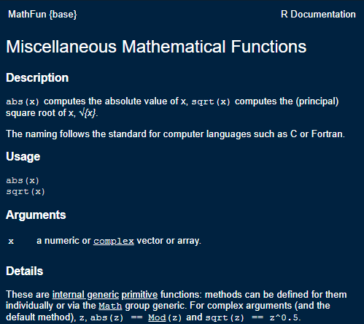
Functions and their arguments
?sqrt
a <- sqrt(100)
a

Slide 70
Functions and their arguments
?round
Syntax: round(x, digits = 0)
Arguments
x a numeric vector
digits integer indicating the number of decimal places
round(3.14159, digits = 0)
round(3.14159, digits = 2)

Slide 71
Q & A
What are some common functions you use?

Slide 72
Common functions you may use
Some common functions you may use:
mean()
median()
mean()
max()
summary()

Slide 73
Missing data
Missing data are represented in vectors as NA
Most functions will return NA if the data you work with contains missing values. You can add the argument na.rm = TRUE to calculate the result that ignores the missing value

Slide 74
Let’s add a row to our first_df
The pipe operator %>% allows us to chain a series of commands.
Takes output on the left of %>% as the input of the function on the right
No assignment operator
first_df %>%
add_row(countries = "Peru", emissions = NA)
first_df

Slide 75
Let’s add a row to our first_df
With assignment operator
first_df <- first_df %>%
add_row(countries = "Peru", emissions = NA)
first_df

Slide 76
Missing data
To take the mean of emissions, we use the mean() function
mean(first_df$emissions)
mean(first_df$emissions, na.rm = T)

Slide 77
Replacing missing values
Let’s say we were told that Peru’s emissions are 100.
first_df %>%
mutate(emissions = ifelse(countries == "Peru", 100, emissions))
first_df # why has it not changed?

Slide 78
Replacing missing values
Alternate way of doing it
first_df$emissions[is.na(first_df$emissions)] <- 100
This coding style may be more similar to what you may see in FRE 501.
Notes:
Easily drop

Slide 79
Writing your own functions
Sometimes, you will find it useful to write your own functions.
The syntax of a function is
function_name <- function(arg1, arg2, …){
statements # do something interesting
object # return value
}
Use a meaningful name to call your function
compute_standard_error instead of func1

Slide 80
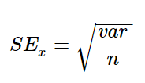
Writing your own functions
R does not have a built in function to calculate standard errors.
sqrt(var(first_df$emissions, na.rm = T) / length(first_df$emissions))
Notes:
Treating NA’s

Slide 81
Writing your own functions
But what if you have to compute the SE for multiple variables?
Copy pasting the formula and editing variable names can lead to mistakes

Slide 82
Writing your own functions
Write your own function instead
std_error <- function(x){
sqrt(var(x, na.rm = T) / length(x))
}
std_error is the function name
x is the argument, which is a numeric vector in this example
Every time we pass a vector to this function, it will compute the formula provided in the body of the function.

Slide 83
Writing your own functions
Let’s add the country’s GDP to first_df using the add_column() function. Then calculate its standard error.
first_df <- first_df %>%
add_column(gdp = c(50300, 1090, 52100, 6110))
std_error(first_df$gdp)
std_error(first_df$emissions)

Slide 84
Best practices
It is recommended to write your functions at the top of your script.
If you write a bunch of related functions, save these functions in a separate script.
You can call these functions into your current script using the source() function.

Slide 85
Importing a function
source(here(“code”, “price_function.R”))
You will now see a get_delta() function in your Environment

Slide 86
What we just did
Create, name, and assign values to objects
Use comments to inform script
Inspect, manipulate, and subset vectors, lists, and data frames
Call functions and use arguments to change default options
Deal with missing values in objects
Write your own function
Import your own function
Notes:
Phrase this as a question?

Slide 87
Day 2

Slide 88
Functions
Why do we use functions?
Reduce likelihood of errors!

Slide 89
Standard Errors
first_df <- data.frame(countries = c(“Canada”, “Kenya”, “United States”, “Peru”), emissions = c(53700, 14300, 5250000, NA), gdp = c(250, 100, 350, 120))
first_df
Using yesterday’s formula, calculate SE of (1) emissions, and (2) gdp
sqrt(var(first_df$emissions, na.rm = T) / length(first_df$emissions))
sqrt(var(first_df$gdp, na.rm = T) / length(first_df$gdp))

Slide 90
Q: Ignoring NA in SE calculation
Oliver’s suggestion
Denominator = length – number of NA
length(first_df$emissions) – sum(is.na(first_df$emissions)
I misplaced my parentheses yesterday
sqrt(var(first_df$emissions, na.rm = T) / (length(first_df$emissions) - sum(is.na(first_df$emissions))))

Slide 91
Q: Ignoring NA in SE calculation
Ana’s suggestion
use the na.omit() function
sqrt(var(first_df$emissions, na.rm = T) / length(na.omit(first_df$emissions)))

Slide 92
Functions
Instead of repeating the code twice and just changing the variable name (e.g. emissions and gdp), we create a function
sqrt(var(first_df$emissions, na.rm = T) / length(na.omit(first_df$emissions)))
std_error <- function(x){
sqrt(var(x, na.rm = T) / length(na.omit(x)))
}

Slide 93
Without Using Functions
Wrong functions:
sqrt(var(first_df$emissions, na.rm = T) / length(first_df$emissions))
sqrt(var(first_df$gdp, na.rm = T) / length(first_df$gdp))
Correct functions:
sqrt(var(first_df$emissions, na.rm = T) / length(na.omit(first_df$emissions)))
sqrt(var(first_df$gdp, na.rm = T) / length(na.omit(first_df$emissions)))

Slide 94
But if you used a function
Just change the one in red
std_error <- function(x){
sqrt(var(x, na.rm = T) / length(na.omit(x)))
}
std_error(first_df$emissions)
std_error(first_df$gdp)

Slide 95
Q: How to drop certain rows?
first_df <- data.frame(countries = c("Canada", "Kenya", "United States", "Peru"), emissions = c(53700, 14300, 5250000, NA))
first_df
first_df <- first_df %>%
add_row(countries = "Philippines", emissions = 200) %>%
add_row(countries = "Philippines", emissions = 10000) %>%
add_row(countries = "Mexico", emissions = 200)

Slide 96
Q: How to drop certain rows?
# drop row five
no_row_5 <- first_df[-5,]
no_row_5
Notice that we no longer have a row with index 5
Google how to reset row index after dropping row in R
Notes:
Rownames(no_row_5) <- NULL

Slide 97
Q: How to drop certain rows?
Let’s say I want to drop rows 1, 3, 5
subset_1 <- first_df[-c(1,3,5),]
{dplyr} way – use slice()
Row index reset
subset_1a <- first_df %>%
slice(-c(1,3,5))

Slide 98
Q: How to drop certain rows?
I want to drop from rows 4 onwards
subset_2 <- first_df[-c(4:nrow(first_df)),]
subset_2a <- first_df %>%
slice(-(4:n()))

Slide 99
Q: How to drop certain rows?
What are potential issues with dropping rows based on index?

Slide 100
Q: How to drop certain rows?
What are potential issues with dropping rows based on index?
What if you sorted data differently?

Slide 101
Q: How to drop certain rows?
Let’s sort the countries column alphabetically then drop rows 1, 3 ,5
subset_1b <- first_df %>%
arrange(countries) %>%
slice(-c(1, 3, 5))
subset_1b
subset_1a

Slide 102
Q: How to drop certain rows?
So it is still best to drop rows using a unique identifier
Drop Philippines with emissions = 200
first_df %>%
filter(countries != “Philippines” | emissions != 200)

Slide 103
Q: coding in editor vs console
Editor
Anytime you type code here, R will not automatically run that line of code for you
You can save your code an return to it later
Console
Anytime you type code here, R will automatically run that line of code when you click ‘enter’
Codes run here will be ‘forgotten’ by R once you close or restart your session
Use it for quick calculations, quick view, etc.

Slide 104
Importing Data
Load data in different ways
Flat files (csv and txt)
Excel file (xlsx)
Stata data format (dta)
Google Sheet
API

Slide 105
Flat files
csv files
carbon <- read_csv(here("data", "yearly_co2_emissions.csv"))
carbon <- read.csv(here("data", "yearly_co2_emissions.csv"), sep = ",", header = TRUE)
sep = “,” means that the data is comma delimited
header = TRUE indicates that the first row is variable names

Slide 106
Flat files
Txt files
provinces <- read.table(here("data", "province.txt"), sep = "\t", header = TRUE)
sep = “\t” means that the data is tab delimited
header = TRUE indicates that the first row is variable names

Slide 107
Excel files
xlsx files
gdp <- read_xlsx(here("data", "gdp_pc.xlsx"))
If data is stored in separate sheets,
energy_hist <- read_xlsx(here("data", "energy_use_per_person.xlsx"), sheet = 1)
energy_recent <- read_xlsx(here("data", "energy_use_per_person.xlsx"), sheet = 2)
Part of {readr} package

Slide 108
Merge
Let’s merge or join the two energy files we just loaded into R.
energy <- full_join(energy_hist, energy_recent, by = c("country"))
energy_basemerge <- merge(energy_hist, energy_recent, by = c("country"), all.x = TRUE, all.y = TRUE)

Slide 109
Stata files
Stata files
politics <- read.dta13(here("data", "politics.dta"), nonint.factors = TRUE)
The argument `nonint.factors = TRUE` is to keep factor labels instead of the value itself. You can try loading the data with and without that argument to see the difference.

Slide 110
Google Sheets
gs4_deauth() # so no need to sign in
disasters <- read_sheet("https://docs.google.com/spreadsheets/d/17s15o7jdDpGSKgsIboZdnYU2UxHtU9DHKNRmYVVgwJo/edit#gid=0", skip = 2)
The argument “skip = 2” tells R to start reading the data from the third row.

Slide 111
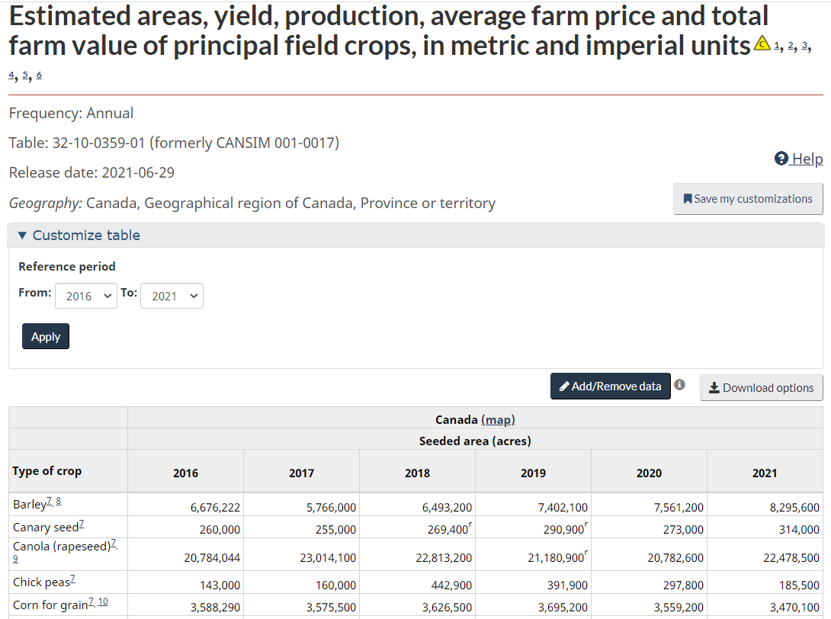
API
Let’s say you want to work with this table from Statistics Canada.

Slide 112
API
You can download the Excel file, save it in your computer, and load it using one of the functions discussed earlier.
Or you can use the {cansim} package which connects straight to the Statistics Canada database.
ag <- get_cansim('32-10-0359-01')

Slide 113
What we just did
Load data in different ways
Flat files (csv and txt)
Excel file (xlsx)
Stata data format (dta)
Google Sheet
API

Slide 114
Viewing your data
You can view your data with the command View(dataframe_name) or by clicking the data object in your Environment tab
The ability to click and look at your data is an advantage of using an Rstudio over R.

Slide 115
Inspecting your data
Here are a few functions to inspect your data
Size
dim(politics)
nrow(politics)
ncol(politics)
Content
head(politics) or tail(politics)
politics %>% slice_head(n = 7)
politics %>% slice_sample(n = 10)

Slide 116
Inspecting your data
Column Names
names(politics)
Summary
str(politics)
summary(politics)
glimpse(politics)

Slide 117
Subsetting Data Frames
Recall that we use [ ], [[ ]], or $ to extract certain columns and rows from our data frame.
politics[1, 2]
politics[c(5:10), ] #extract rows 5-10 and all columns
politics[c(5:10), c(1:3)] #extract rows 5-10 and columns 1-3
politics$country #extract the country column **
table(politics$country)

Slide 118
Q & A
How would you describe the carbon and gdp data frames?
How are they similar/different from the politics data frame?

Slide 119
Research Question
From this point on, we will just look at the carbon, gdp, and politics data frames.
We want to explore the following research questions:
Do richer countries emit more carbon emissions?
If we have time: How does a country’s level of democracy affect emissions?

Slide 120
Tidy Data
Now that we have our data in R and know what it looks like, we want to make sure that the data is in tidy format before we proceed with any analysis.

Slide 121

Tidy data
"Illustrations from the Openscapes blog Tidy Data for reproducibility, efficiency, and collaboration by Julia Lowndes and Allison Horst"

Slide 122
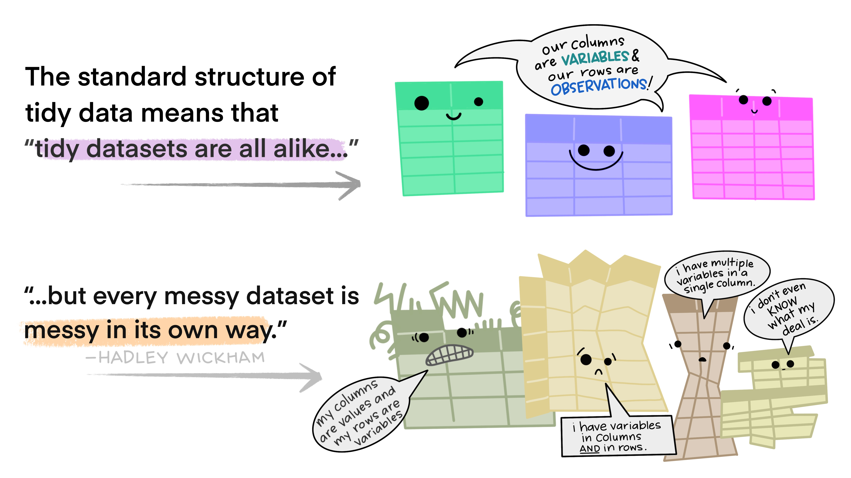
Tidy data

Slide 123
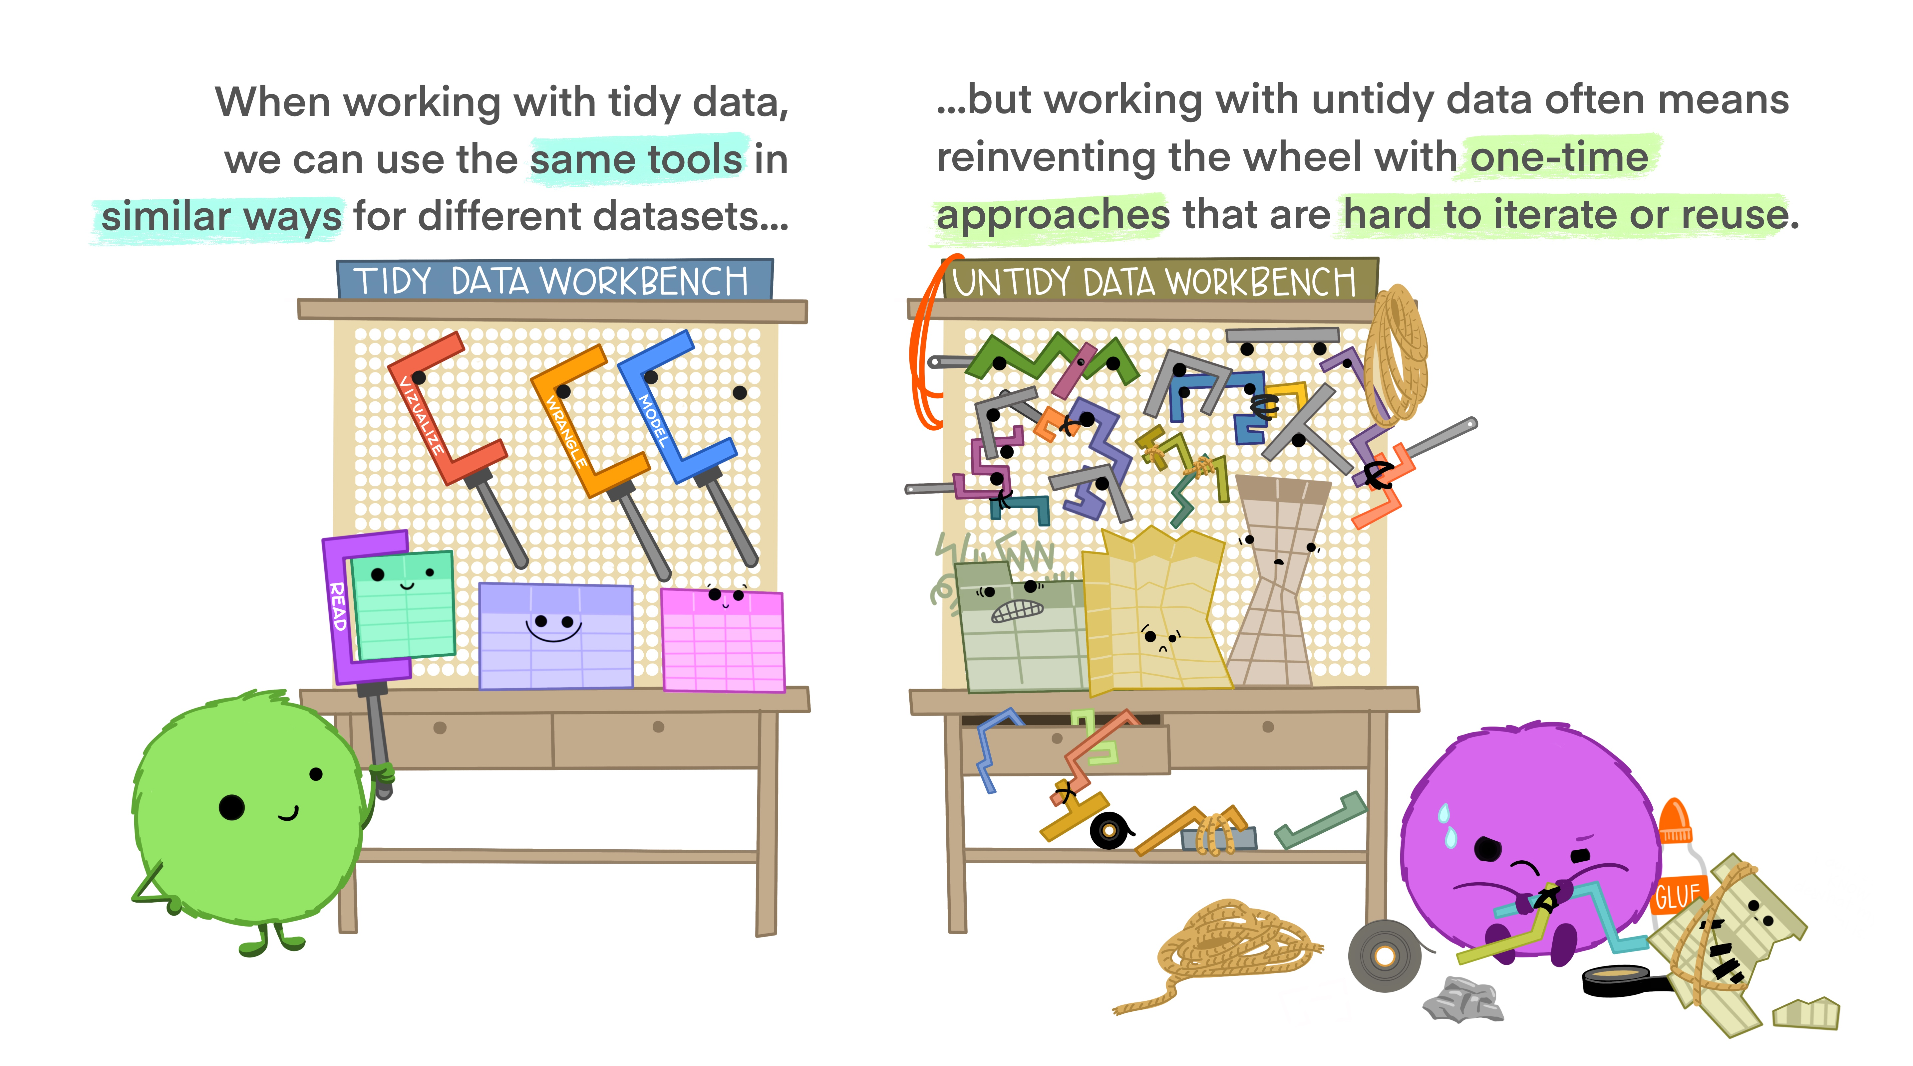
Tidy data

Slide 124
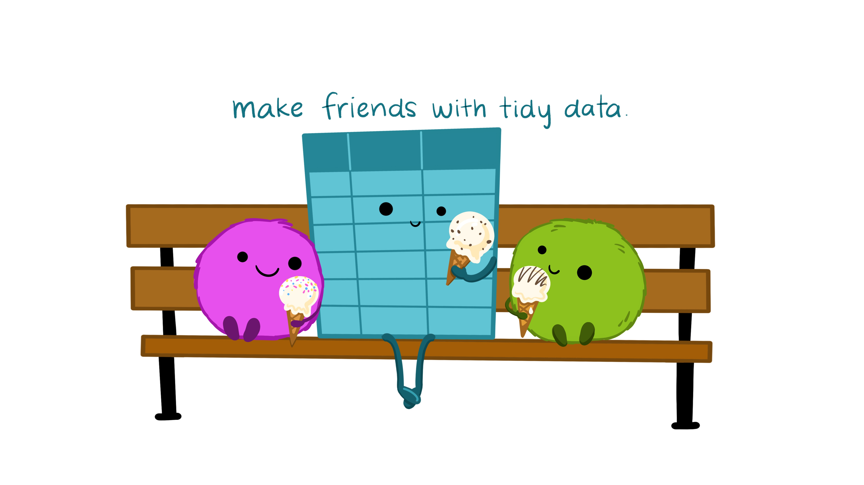
Tidy data

Slide 125
Reshaping data
Politics data is in the “long” format
Each row contains the values of variables associated with each country and year
Data is in the tidy format
country | year | V2x_libdem
Myanmar | 2012 | 0.137
Myanmar | 1997 | 0.018

Slide 126
Reshaping data
Carbon and gdp data is in a “wide” format.
This format means that each variable (i.e. emissions for 1751, emissions for 1752, and so on) is listed as its own column.
Data is not tidy
R functions expect your data to be in the “long” format because it is more machine readable.
country | 1751 | 1752 | 1753
Afghanistan | NA | NA | NA
Albania | NA | NA | NA

Slide 127
Note on column names
You might notice that in the carbon and gdp data, the column names are numeric. This practice is not recommended.
To refer to these columns, you will have to wrap them with backticks (`)
carbon$`2014`

Slide 128
Reshaping data
We want to convert carbon to a “long” format to make it more useful for visualization and analysis.
A “long” format means that we will have fewer columns than the current format (“wide”)
We want to collapse all emissions across the years into one new variable called “emissions.”
We identify what year the data point is from by creating a “year” variable

Slide 129
Reshaping data
country | 1751 | 1752 | 1753
Afghanistan | a | b | c
Albania | d | e | f
country | Year | emissions
Afghanistan | 1751 | a
Afghanistan | 1752 | b
Afghanistan | 1753 | c
Albania | 1751 | d
Albania | 1752 | e
Albania | 1753 | f

Slide 130
Reshaping data
We will use the pivot_longer() function.
4 arguments
The wide data
cols are the names of the columns we will use (or not use) to fill the new values variable
names_to refers to the column variable we wish to create the cols provided
values_to refers to the column variable we wish to create and fill with the values associated with the cols provided

Slide 131
Reshaping data
Looking at our carbon data,
4 arguments
wide data – carbon
cols - all columns except country, so –country
names_to – collapse all years to a new column called year
values_to – collapse all emissions values to a new column called emissions

Slide 132
Data Wrangling – reshaping data
carbon_long <- carbon %>%
pivot_longer(cols = -country,
names_to = “year”,
values_to = “emissions”)

Slide 133
Reshaping data
Always good to check if you did it correctly
carbon_long %>% slice_sample(n = 10)
Compare the dimensions of the carbon and carbon_long data frames.
How would you check for this?

Slide 134
Reshaping data
If you take a look at the structure of the data, you will notice that R encoded the year variable as character instead of numeric.
To create or modify columns, use the mutate() function.
carbon_long <- carbon_long %>%
mutate(year = as.numeric(year))
## carbon_long$year <- as.numeric(carbon_long$year)

Slide 135
Reshaping data
The gdp data is also in the same format. Let’s reshape it too. Notice the use of the %>%.
gdp_long <- gdp %>%
pivot_longer(cols = -country,
names_to = "year",
values_to = "gdp") %>%
mutate(year = as.numeric(year),
gdp = as.numeric(gdp))
head(gdp_long)

Slide 136
Reshaping data
In case you need to reshape the data into wide format, read the notes!

Slide 137
Selecting and Filtering
Let’s say you only want to keep certain variables from the politics data. You can use the select() function to perform this task.
You can add a minus sign in front of a variable to drop a variable
politics %>% select(country_name, year, v2x_libdem, v2x_regime, region)
politics %>% select(-v2psnatpar_ord)

Slide 138
Selecting and Filtering
The output of the codes we just ran will just print the data frame.
To save the new data frame, we have to use the assignment operator. We will just overwrite the original politics data.
politics <- politics %>% select(country_name, year, v2x_libdem, v2x_regime, region)

Slide 139
Selecting and Filtering
We can use the filter() function to filter observations.
Min(politics$year, na.rm = T)
Max(politics$year, na.rm = T)
politics <- politics %>% filter(year >= 1991 & year <= 2014)
politics %>% filter(region == "Africa")

Slide 140
Selecting and Filtering
You can also use the %>% to chain the commands
politics <- politics %>%
select(country_name, year, v2x_libdem, v2x_regime, region) %>%
filter(year >= 1991 & year <= 2014)

Slide 141
Renaming columns
To rename variables, the syntax is rename(new_name = old_name)
politics <- politics %>%
rename(country = country_name,
democracy = v2x_libdem,
regime = v2x_regime)
## also does the same thing names(politics)[which(names(politics) == "country")] = "country"

Slide 142
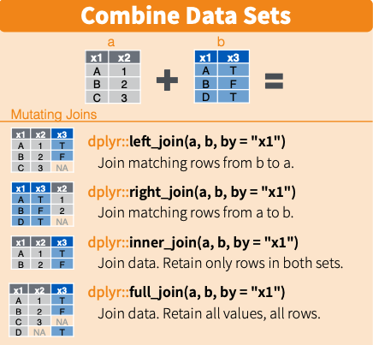
Joining data together

Slide 143
Joining data together
I want to keep all the observations in the carbon_long data, and join/merge with the gdp_long and politics data
data <- carbon_long %>%
left_join(gdp_long, by = c("country", "year")) %>%
left_join(politics, by = c("country", "year")) %>%
filter(!is.na(emissions) & !is.na(region) & !is.na(gdp)) %>%
filter(year >= 1991 & year <= 2014)

Slide 144
Another way to join
Use the merge() function
carbon_gdp <- merge(carbon_long, gdp_long, by = c("country", "year"), all.x = TRUE)
merged <- merge(carbon_gdp, politics, by = c("country", "year"), all.x = TRUE)

Slide 145
Creating new variables
Let’s say we want to create a new variable.
data <- data %>%
mutate(gdp_sq = gdp * gdp)
Or
data$gdp_sq <- data$gdp * data$gdp
Notes:
https://hhsievertsen.github.io/applied_econ_with_r/#5_Descriptive_Charts

Slide 146
Descriptive statistics
We can show some summary statistics using the following commands
mean(data$emissions, na.rm = T)
table(data$country)
summary(data)
summary(data$emissions)

Slide 147
Descriptive statistics
We can also compute summary statistics by region using group_by() and summarize() functions
data %>% group_by(region) %>%
summarize(n = n(),
avg_emissions = mean(emissions, na.rm = T),
median_gdp = median(gdp, na.rm = T))

Slide 148
Descriptive statistics
You can also use the arrange() function to sort values.
data %>% group_by(region) %>%
summarize(n = n(),
avg_emissions = mean(emissions, na.rm = T),
median_gdp = median(gdp, na.rm = T)) %>%
arrange(desc(median_gdp), desc(avg_emissions))

Slide 149
Descriptive statistics
We can use the {modelsummary} package to generate nice looking tables. Read here for more ways to customize your table.
datasummary_skim(politics)
datasummary_skim(data, type = "categorical")
# To export
datasummary_skim(data, output = here("output", "categorical_summary_statistics.html"))

Slide 150
Data Visualization
There are {base} R functions to plot data, such as plot() and hist()
We will focus on ggplot2. Read this tutorial/book for an in-depth intro.
ggplot2 is based on the “Grammar of Graphics that allows you to compose graphs by combining independent components...The grammar tells us that a graphic maps the data to the aesthetic attributes (color, shape, size) of geometric objects (points, lines, bars)”

Slide 151
Data Visualization
There are 3 main components in every ggplot2 plot.
The data
A set of aesthetic mapping
At least one layer that describes how to render each observation
Common layers
geom_line() for trend lines, time series, etc
geom_point() for scatter plots
geom_boxplot() for boxplots
geom_bar() and geom_col() for bar charts
geom_histogram() for histograms

Slide 152
Scatterplots
Let’s try to visualize the relationship between the gdp and emissions variables in our data data frame (Sorry, should have named the data frame differently!)
The data = data
Aesthetics = gdp mapped to the x axis, emissions to the y axis
Layer = points or geom_point()

Slide 153
Scatterplots
options(scipen=99999) # turn off scientific notation
ggplot(data, aes(x = gdp, y = emissions)) +
geom_point()

Slide 154
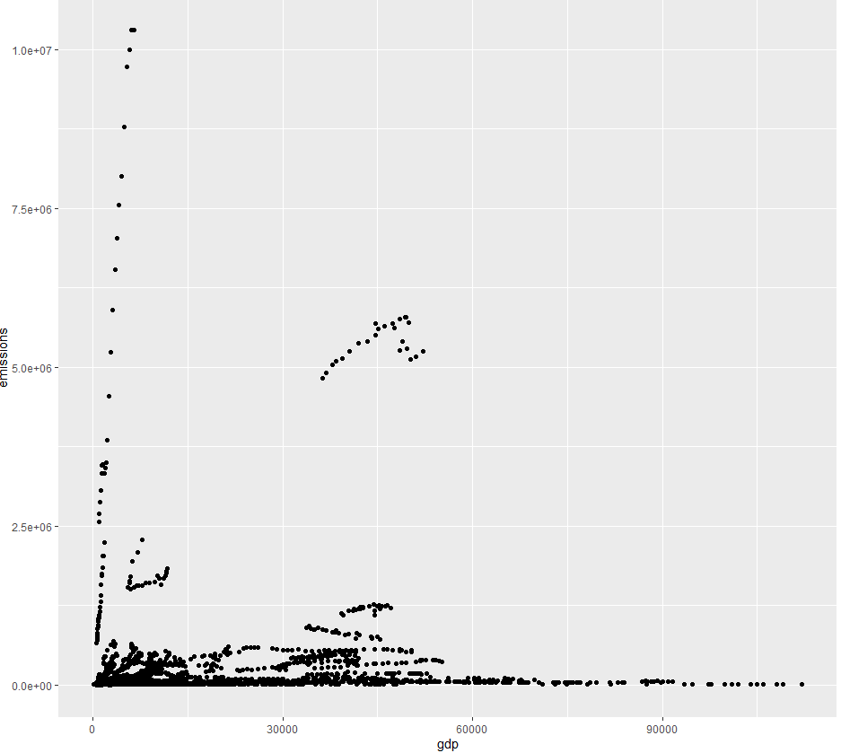

Scatterplots

Slide 155
Scatterplots
ggplot(data, aes(x = log(gdp), y = log(emissions))) +
geom_point()
The data and aesthetic are inside the ggplot() function. The layer is added with a +.
Since most maps plots a variable to x and y, first two arguments in aes() will be mapped to x and y.
ggplot(data, aes(log(gdp), log(emissions))) +
geom_point()

Slide 156
Scatterplots
We can also plot another variable to our plot by using other aesthetics such as color, shape, and size.
This code changes the color of the point based on the country’s region.

Slide 157
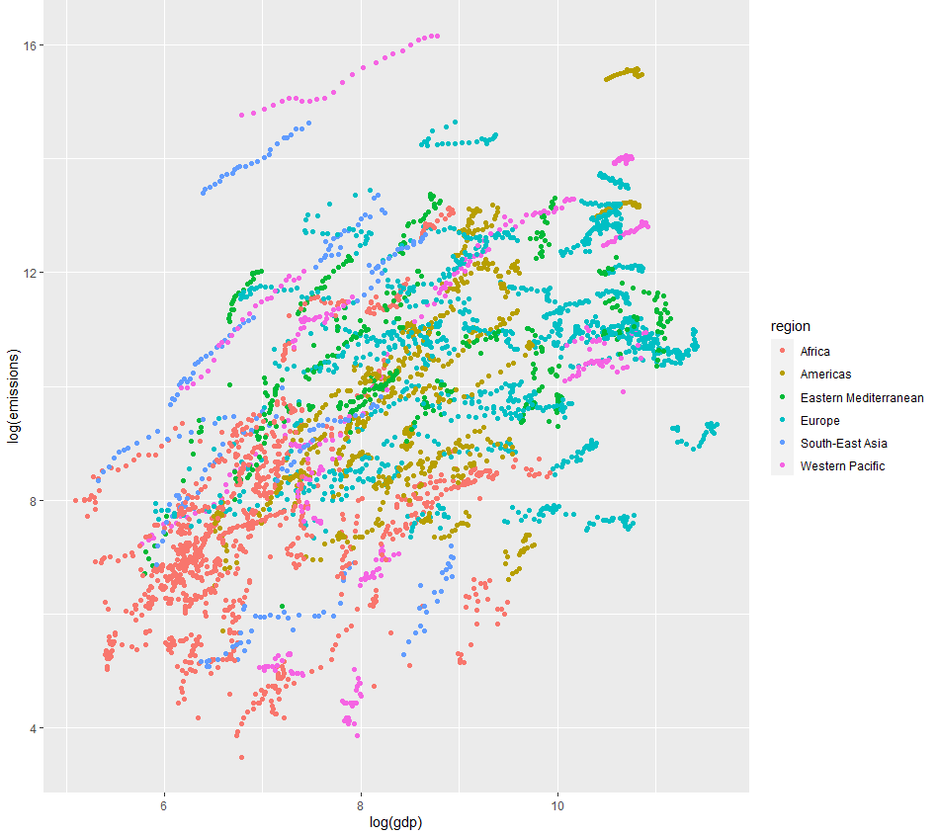
Scatterplots
ggplot(data, aes(log(gdp), log(emissions), color = region)) +
geom_point()

Slide 158
Scatterplots
We can also use the pipe operator with ggplot2. This method is useful if you want to make changes to the data (e.g. filter or mutate) before plotting.
Let’s calculate the average emissions and average GDP per country. Then plot it.
This will be my “base” graph so I will assign the plot to object p. I can add more layers to p later on.

Slide 159
Scatterplots
p <- data %>%
group_by(country) %>%
mutate(avg_emissions = mean(emissions, na.rm = T),
avg_gdp = mean(gdp, na.rm = T)) %>%
ggplot(aes(log(avg_gdp), log(avg_emissions))) +
geom_point()
p

Slide 160
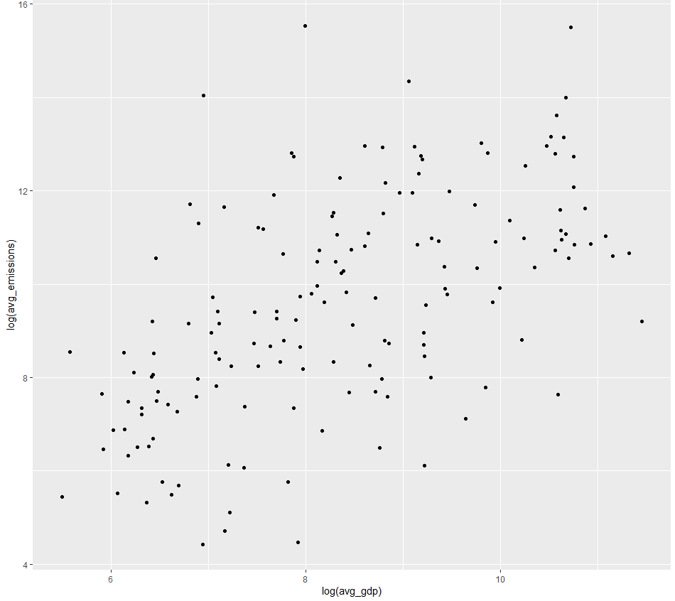
Scatterplots

Slide 161
Adding layers
We build our plots iteratively. Now let’s add a title and label the axes. Since we already saved the base plot to object p, we can just add layers to using +.
p <- p + labs(title = "Relationship between Emissions and GDP",
y = "Log GDP per capita", x = "Log CO2 per capita")
p

Slide 162
Adding a trend line
We can add a fitted line using geom_smooth(). If we want a fitted line based on a linear model, we have to specify it using geom_smooth(method = “lm”)

Slide 163
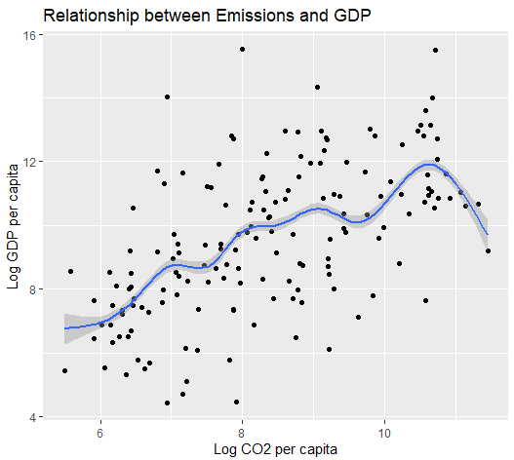
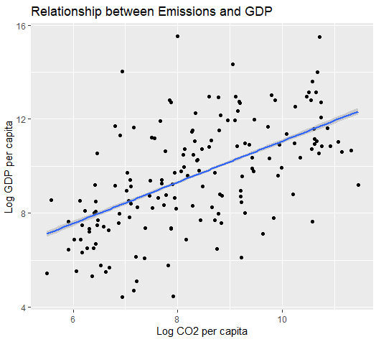
Adding a trend line
p + geom_smooth()
p + geom_smooth(method = “lm”)

Slide 164
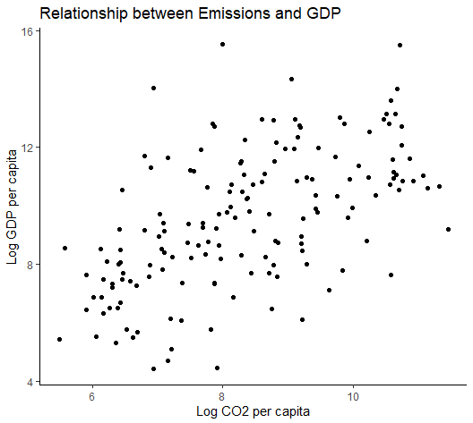
Changing the theme
There are different themes available. Let’s say we want to use the theme_classic()
“A classic-looking theme, with x and y axis and no grid lines”
p <- p + theme_classic()
p

Slide 165
Saving the plot
The recommended practice is to use the ggsave() function.
Use the Export button in the ‘Plots’ tab, but this action is not good for reproducibility.
Please don’t just take the a screenshot of the image!
Can save as png, jpg, pdf, etc.
ggsave(p, filename = here("output","emissions_gdp.png"))

Slide 166
Boxplots
bp <- data %>%
filter(year == 2010) %>%
ggplot(aes(region, gdp)) +
geom_boxplot() +
labs(title = "Distribution of GDP by Region, 2010",
y = "GDP per capita", x = "Region") +
theme_classic()
bp

Slide 167
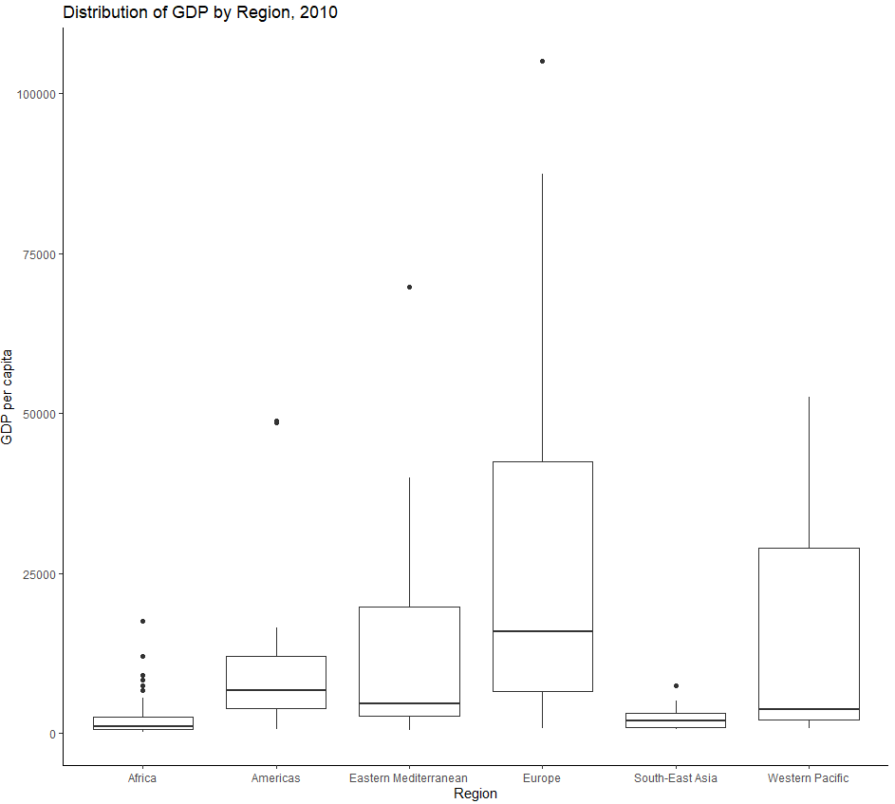
Boxplots

Slide 168
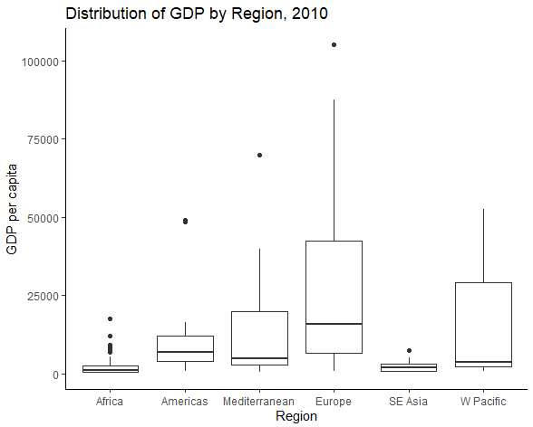
Edit the tick marks
bp + scale_x_discrete(labels = c("Africa", "Americas", "Mediterranean", "Europe", "SE Asia", "W Pacific"))

Slide 169
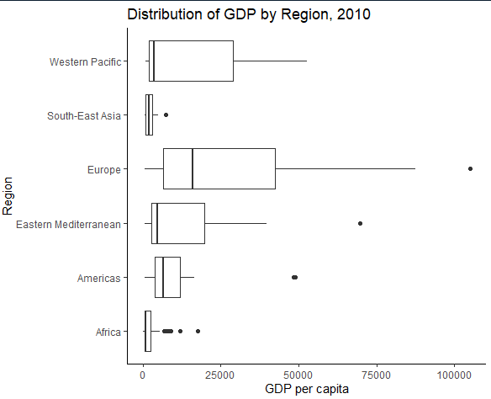
Flipping the coordinates
bp + coord_flip()

Slide 170
Line plots
Let’s plots Canada’s emissions over time
lp <- data %>%
filter(country == "Canada") %>%
ggplot(aes(x = year, y = emissions)) +
geom_line(linetype = "dashed", color = "red") +
theme_classic() +
labs(title = "Canada's CO2 emissions, 1991-2014",
y = "Total Emissions",
x = "Year")
lp

Slide 171
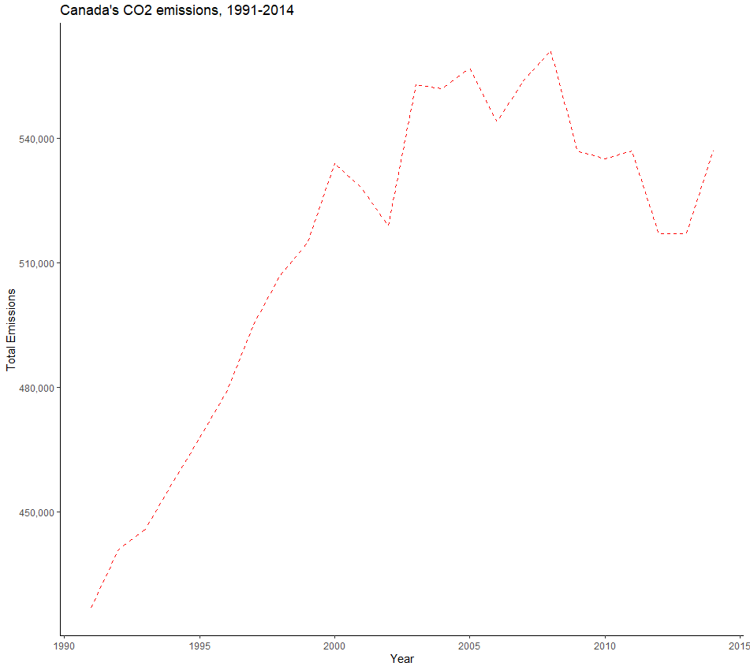
Adding a comma to the scale
lp + scale_y_continuous(labels = scales::comma)

Slide 172
Histogram
ggplot(data, aes(x = gdp)) +
geom_histogram() +
theme_classic() +
labs(title = "Income Distribution, 1991-2014",
y = "Count",
x = "GDP per capita")

Slide 173
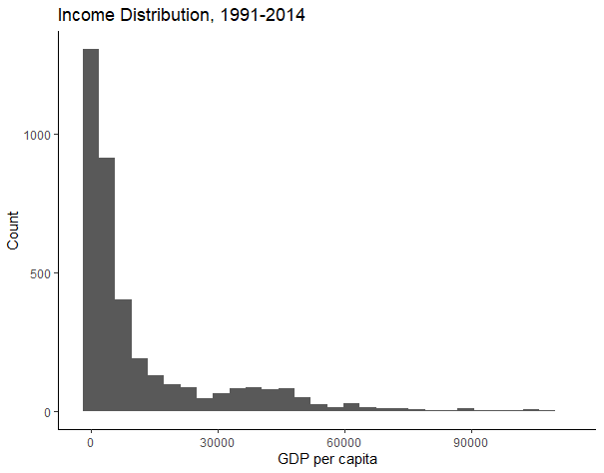
Histogram

Slide 174
Analysis
Pairwise t-test
Correlation
Regression

Slide 175
Comparing CAN & AUS
Let’s compare the carbon emissions of Canada and Australia.
data %>%
filter(country == "Canada" | country == "Australia") %>%
group_by(country) %>%
ggplot(aes(x = country, y = emissions)) +
geom_boxplot() +
labs(title = "Comparing Canada and Australia's emissions, 1991-2014",
y = "Emissions",
x = "Country")

Slide 176
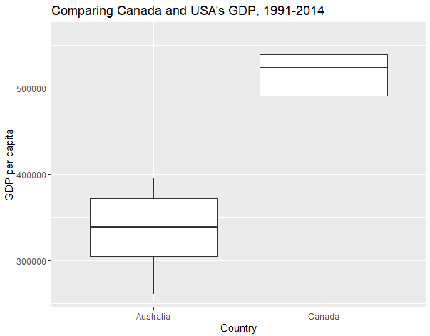
Comparing CAN & AUS

Slide 177
t-test
can_aus <- data %>%
filter(country == "Canada" | country == "Australia")
options(scipen = 0) # to allow for scientific notation again
can_aus_ttest <- t.test(emissions ~ country, data = can_aus)
can_aus_ttest

Slide 178
Correlation
How related are country’s average emissions and average GDP?
data <- data %>%
group_by(country) %>%
mutate(avg_emissions = mean(emissions, na.rm = T),
avg_gdp = mean(gdp, na.rm = T))

Slide 179
Correlation
cor <- cor.test(data$avg_emissions, data$avg_gdp, method = "pearson")
cor
str(cor)
cor$estimate

Slide 180
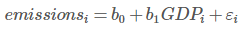
Regression
reg1 <- lm(emissions ~ gdp, data = data)
reg1
summary(reg1)
str(summary(reg1))
summary(reg1)$coefficients

Slide 181
Exporting results
tidy_reg1 <- tidy(reg1)
write_csv(tidy_reg1, file = here("output", "tidy_reg1.csv"))
modelsummary(reg1,
coef_rename = c("gdp" = "GDP", "(Intercept)" = "Intercept"),
stars = TRUE, statistic = 'std.error',
fmt= '%.4f',
gof_omit = 'DF|AIC|BIC|Log|R2 Adj.',
output = 'flextable')

Slide 182
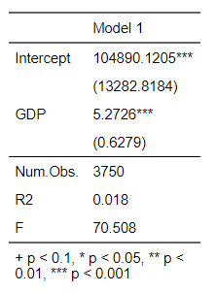
Exporting results

Slide 183
What we just did
Conduct pairwise t-test
Calculate the correlation coefficient
Run an OLS regression in R

